Slide 1
Risk Assessment & Safety Management: Making Program Decisions in the COVID-19 Era
Rick Curtis www.OutdoorEd.com www.IncidentAnalytix.com
Copyright © Rick Curtis 2020
Notes:
Introduction

Slide 2
Introduction
Rick Curtis
Pronouns: he, him, his
Director, Princeton University Outdoor Action Program: 38 Years
Author: The Backpacker’s Field Manual
Founder: www.OutdoorEd.com
Founder: www.IncidentAnalytix.com

Slide 3
Learning Objectives
Learn how to implement the Risk Assessment & Safety Management Model (RASM) of Contributing Factor Analysis and Mitigating Factor Analysis to manage risk more effectively.
Learn how the Safety I framework and Safety II framework are complementary parts of an overall risk management plan.
Determine when factors are ‘in scope’ allowing actionable steps to be implemented for managing risk or ‘out of scope’ limiting organizational response.
Understand the role that incident data collection plays in the analysis of accident and near misses through building Accimaps and Preventimaps.
Notes:
The objectives of this presentation are to:
Define Risk
Identify the major causal factors in accidents/near misses
Explore a model for managing risk that incorporates the major causal factors
Identify best practices for assessing and managing risk before an event
Identify procedures for evaluating risk and mitigating it in the field

Slide 4
Defining Risk/Reward
-R: Negative R (Risk) is the potential for loss, injury, illness
+R: Positive R (Reward) is the potential for gain, growth, development
Notes:
In this model there are two different types of risk the first is what I call Negative R(isk) or Negative R. Negative R is the potential for loss injury or illness which is what we typically associate with accidents in the field. Positive R(isk) or Positive R is the potential for gain growth and development. So in all of our programs, we have both Negative R and Positive R.
We all know about the negative model of risk, what is the positive side of risk in our industry? Risk is an underlying principal in all of outdoor and adventure education. The fundamental philosophical principles of Kurt Hahn and others is that the exposure to risk/challenge is what impels people to personal growth.
Each program has to evaluate the level of Negative R that is appropriate for your organization's mission. For example, in my work running wilderness orientation programs for incoming college freshmen, the level of Negative R that is appropriate to accomplish our mission is low. However, if I am working in a therapeutic program with serious drug offenders, the consequences for them not getting off drugs have huge Negative R so I would tolerate running a program that might have a higher Negative R in order to influence behavior change.

Slide 5
Balancing Risk & Reward
-R
+R

Slide 6
Risk is…
Inherent: -R exists in outdoor adventure activities
Expected: -R can occur at any time
Integral: -R and +R are essential parts of our program
Determine the appropriate level of –R for your program
Notes:
So risk is inherent in our programs. That is Negative R exists in all adventure activities. Risk is expected. Negative R can occur at any time so we have to expect the unexpected. Risk is manufactured. We plan programs with the understanding that there is some Negative R. In fact our programs wouldn't function without some level of Negative R. And finally risk is integral. Both Negative R and Positive R are essential parts of our programs.

Slide 7
An Incident is either…
Adverse Outcome
Close Call/Near Miss
Notes:
Ask the audience to define an Incident. Bring up the difference between an Incident and a Close Call/Near Miss.

Slide 8
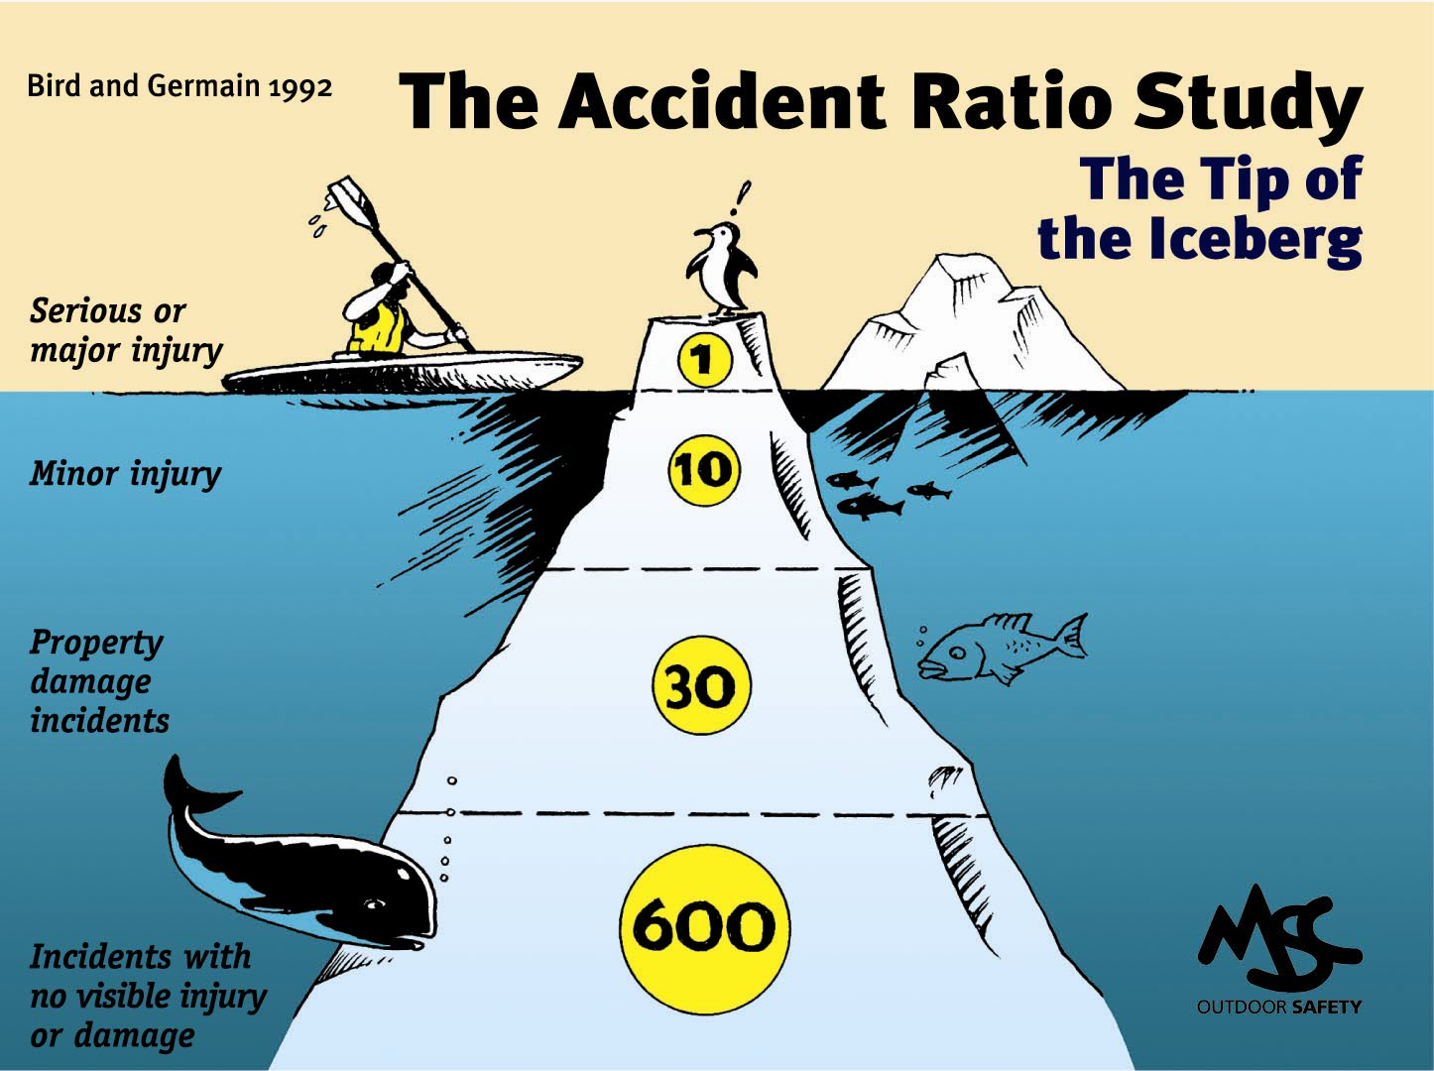
The Accident Iceberg
Graphic from the New Zealand Mountain Safety Council
Notes:
Some of you may be familiar with what is called the Accident Iceberg or the Accident Pyramid. What do we know about in Iceberg – that 90% is actually underwater and can’t be seen. This is based on the work of Bird and Germain studying accidents in industrial settings. It has been replicated in 2003 by Conoco Philips and is generalized here for the outdoor industry.
Their research showed that for every serious or major injury there would be 10 minor injuries, 30 cases of property damage and 600 close calls. Based on this model what is the most predictive data point for the Risk Level of a particular activity – the near misses.

Slide 9
Types of Incidents
Injury
Illness
Motivational/Behavioral
Bias Incident
Bullying
Inappropriate Sexual Contact
Property Damage
Crime

Slide 10
The Risk Assessment Safety Management (RASM) Model

Slide 11
Risk Level
The interaction of Hazard Factors and Safety Factors creates the Risk Level.
There is no such thing as an overall Risk Level of Zero.
Notes:
Risk Levels are levels of increasing risk and therefore increased potential for accidents.
Risk Level is assigned to an ascending scale of 1 to 5 (arbitrary).
The interaction of Hazard Factors and Safety Factors creates the Risk Level.
There is no such thing as a Risk Level of Zero. – in any activity the overall risk level cannot be zero

Slide 12
Risk Formula
Probability * Severity = Risk Level
Notes:
The formula for determining the level of Risk is
RISK = PROBABILITY OF OCCURENCE * SEVERITY OF OUTCOME

Slide 13
Risk Formula
How Likely? * How Bad? = Risk Level
Notes:
The formula for determining the level of Risk is
RISK = HOW LIKELY * HOW BAD

Slide 14
Risk Level Matrix
Probability | High
 | Medium
 | Low
 |  | Low | Medium | High
 | Severity of Consequences

Slide 15
Assess your Risk Level
Go
Stop
Caution

Slide 16
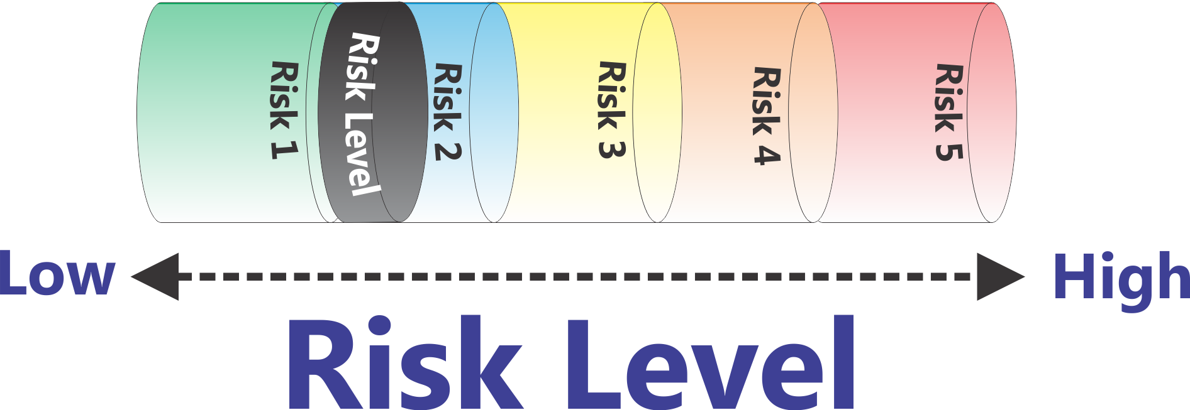
‘Flattened’ Matrix
Low
High
Risk Level
Notes:
Here is a representation of increasing Risk Levels. As the Risk goes up (Probability * Severity) then the piston goes up.
In this particular demonstration of the RASM model we are arbitrarily setting the risk level with a scale of one to five. What risk scale you actually use is up to you. This five point scale is based on the U.S. Department of Homeland Security Threat (Risk) Advisory level. (Low - Green, Guarded - Blue, Elevated - Yellow, High – Orange, Severe – Red)
Can the risk level ever be zero? No, there is no such thing as a risk level of zero. Whenever we send out a trip or run a program there is some level of risk. The question is to determine at an organizational level what level of risk you are comfortable operating your program at.

Slide 17
Identifying Hazards
Any Risk Management Assessment approach requires a Taxonomy of Causation
For today we will use: Equipment, Environment, People
Within that Taxonomy we can identify Hazards which increase the probability and/or severity of an incident
We can think of Hazards as Balls which have a certain size and weight.
Big Hazards have a greater impact on the Risk Level than Small Hazards

Slide 18
Risk Assessment & Safety Management Model (RASM) ©
Environment
People
Equipment
Low
High
Risk Level
Notes:
So let's take a look at the overall risk assessment and safety management model in the following graphic. What you see here can be thought of as a simple balance scale. If we look on the left side we see a series of hazard factors that fall into three categories: Environmental Hazards, Equipment Hazards, and People Hazards (aka Human Factor Hazards) . In the center we see risk levels. As Hazard Factors accumulate on the left-hand side of balance scale, here shown as adding balls into the cylinders, the piston in the Risk Level cylinder moves to the right. Increasing the risk level doesn’t mean that you are going to have an accident, just that the potential for having an accident is increasing.
In the case of Tom Hanks and Cast Away scene if I land 1 foot to the left of the coral reef and am uninjured, what is the Risk Level? Answer – the same. This is a Close Call not an Accident but the Risk Level for having the accident occur is the same.
This is a place to remind people of the Risk Formula:
Probability * Severity = Risk Level

Slide 19
Hazard Factors
Environmental Hazards
High Water
Cold Temperatures
Lightning
Equipment Hazards
Improper gear
Broken equipment
People (Human Factor Hazards)
Medical Conditions
Fatigue
Poor Communication
Fear/Anxiety
Notes:
The actual “balls” that you put into the model are going to be dependent on the types of activities you are doing, your location, etc. Here are some examples of factors (balls) in the Environment, Equipment, and People Hazard categories.
If you want to get more detailed about this you can have the group brainstorm examples of the different categories of Hazard Factors. You can also break the People Factors into different populations (people hazards for everyone in the group, people hazards for participants, people hazards for leaders, and people hazards for the entire group). There are some slides of this in the appendix.

Slide 20
Hazard Factor Impact
Analyzing the actual Hazard is essential in determining the extent to which it is a large or small factor.
Potential Consequences of High Altitude
Mild Altitude Sickness
High Altitude Pulmonary Edema (HAPE)
High Altitude Cerebral Edema (HACE)
High Altitude
Notes:
‘Not All Hazards are the Same Size’ – Have the same impact
Calculating the impact of risk is more than just identifying the particular hazard. It’s also important to recognize that some hazards have more impact than others. One formula that is used for calculating the individual risk is
RISK = PROBABILITY OF OCCURENCE * SEVERITY OF OUTCOME
Let’s take the example of High Altitude. There are a number of illnesses associated with High Altitude.
Mild Altitude Sickness
High Altitude Pulmonary Edema (HAPE)
High Altitude Cerebral Edema (HACE)

Slide 21
Hazard Factors - 10,000 ft
High Altitude (23)
Environment
People
Equipment
Low
Risk Level
High
Notes:
So let's take a look at the overall risk assessment and safety management model in the following graphic. What you see here can be thought of as a simple balance scale. If we look on the left side we see a series of hazard factors that fall into three categories: Environmental Hazards, Equipment Hazards, and People Hazards. In the center we see risk levels. As Hazard Factors accumulate on the left-hand side of balance scale, here shown as adding balls into the cylinders, the piston in the Risk Level cylinder will go up. Increasing the risk level doesn’t mean that you are going to have an accident, just that the potential for having an accident is increasing.
This is a place to remind people of the Risk Formula:
Probability * Severity = Risk Level

Slide 22
Hazard Factors – 18,000 ft
High Altitude (94)
Environment
People
Equipment
Low
Risk Level
High
Notes:
So let's take a look at the overall risk assessment and safety management model in the following graphic. What you see here can be thought of as a simple balance scale. If we look on the left side we see a series of hazard factors that fall into three categories: Environmental Hazards, Equipment Hazards, and People Hazards. In the center we see risk levels. As Hazard Factors accumulate on the left-hand side of balance scale, here shown as adding balls into the cylinders, the piston in the Risk Level cylinder will go up. Increasing the risk level doesn’t mean that you are going to have an accident, just that the potential for having an accident is increasing.
This is a place to remind people of the Risk Formula:
Probability * Severity = Risk Level

Slide 23
Managing the Risk Level
So How Do You Reduce the Risk Level?
Remove all the Hazards you can
What if that’s not Enough?
Add Safety Factors
Notes:
So how to you Manage the Risk Level:
Remove all the Hazards you can
Add Safety Factors

Slide 24
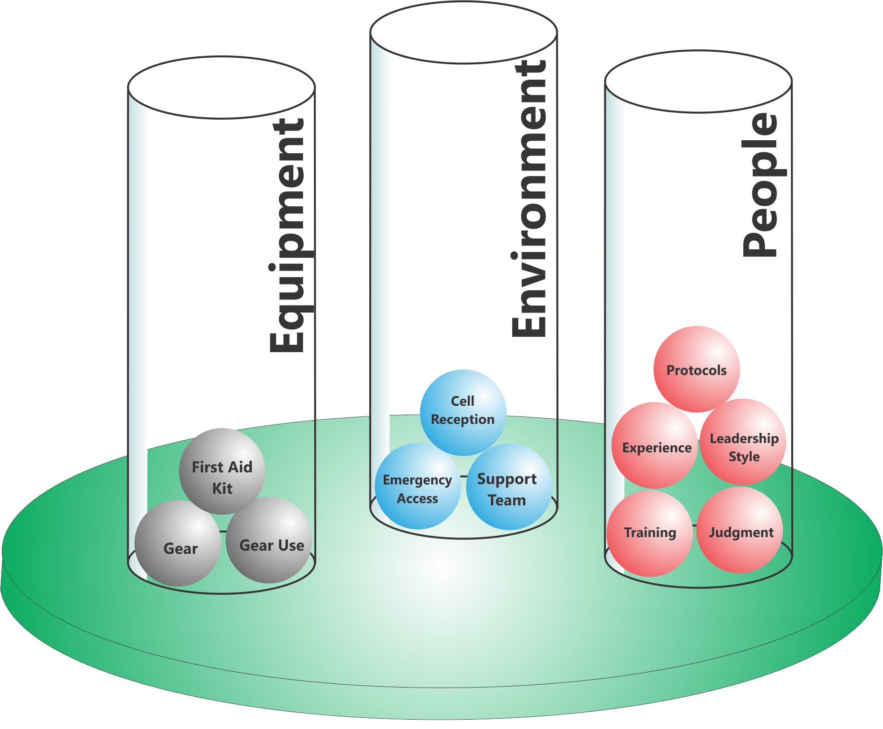
Add Safety Factors
People
Environment
Equipment
Notes:
We can look at adding Safety Factors in the same three areas
Equipment
Environment
People
Going back to our High Altitude Example, what can we do to reduce the risk at 18,000 feet?
Can we eliminate the Hazard Factors (Balls) that are creating the risk? No
What are our other options? Add a Safety Factor
So here is what we did

Slide 25
Risk Assessment & Safety Management Model (RASM) ©
Environment
People
Equipment
Low
High
Risk Level
Notes:
Now we are seeing the other side of the RASM model.
On the right side we now see another part of the balance scale−the Safety Factors−in three categories as before: Environmental Safety Factors, Equipment Safety Factors, and People Safety Factors. When we add “balls” into the Safety Factors we make the risk level go down. Of course it will never go to zero, but we can reduce the risks by adding Safety Factors in.

Slide 26
Safety Factors also have “Weight”
Big Safety Factors have a greater impact on the Risk Level than Small Safety Factors

Slide 27
Risk Assessment & Safety Management Model (RASM) ©
Environment
Environment
People
People
Equipment
Equipment
Low
High
Risk Level
Notes:
So now we are back at the overview of the model and I think you have a good sense of the dynamic interaction that this model provides.
Now let’s put it all together. The Hazard Factors operate to push the Risk Level up while the Safety Factors operate to pull the risk level down. For simplicities sake on the illustrations, all the balls are shown as the same size. As we’ve shown some may be much larger than others and ‘weigh more’ having a much greater or lesser influence on the ultimate Risk Level. For example having a hurricane hit your trip is a massive hazard factor made up of a series of conditions (high winds, downed trees, flooding, temperature, etc.)

Slide 28
Risk Assessment & Safety Management
First Aid Training
People
Allergic Person
People
Benadryl
Equipment
Bees
Environment
Equipment
Epi- nephrine
Hazard Factors
Safety Factors
Low
High
Risk Level
Notes:
I like to reinforce the idea that some hazards can’t be removed and that only by adding Safety Factors in can you reduce the Risk Level. In this example having an environment with bees on the trail and having someone on the trip who is allergic to bees are the things increasing the Risk Level. You can’t remove these things so all you can do is to add Safety Factors on the other side of the equation to reduce the potential severity of the situation if the person gets stung.
Note: Some programs may not carry medications like Benadryl and Epinephrine or allow their staff to use such things. In that case you should come up with your own example that illustrates this point. Or you can refer people back to the Tom Hanks scenario where the waves and the coral reef were still there.

Slide 29
Your Risk Management Approach
Reduce Probability
Reduce Severity
Reduce Both

Slide 30
Steps in RASM
Identify Hazard Factors
Assess Risk Level
Remove Hazard Factors
Assess Risk Level
Add Safety Factors
Assess Risk Level

Slide 31
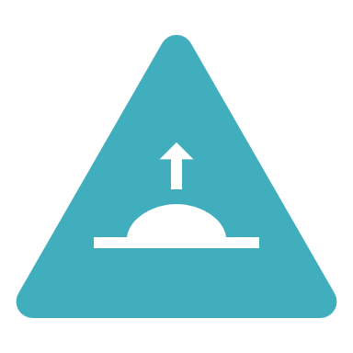
If the Risk Level is still High?
Know when to ‘bail out’
If the Risk Level is too high, what is your expectation of your staff and their expectations?
Notes:
Ask the class what happens when the Risk Level is high and you cannot bring it down to an acceptable level by reducing Hazard Factors or adding Safety Factors. The answer is to bail out. I give a detailed example from my program where leaders have made a good decision by bailing out. They looked at the situation and determined that there was no way to continue without a significant level of risk.
When you can’t bring the risk down, look at ‘changing the game.’

Slide 32
Risk Assessment & Safety Management Model (RASM) ©
Environment
Environment
People
People
Equipment
Equipment
Low
High
Risk Level
Notes:
So now we are back at the overview of the model and I think you have a good sense of the dynamic interaction that this model provides.
Now let’s put it all together. The Hazard Factors operate to push the Risk Level up while the Safety Factors operate to pull the risk level down. For simplicities sake on the illustrations, all the balls are shown as the same size. As we’ve shown some may be much larger than others and ‘weigh more’ having a much greater or lesser influence on the ultimate Risk Level. For example having a hurricane hit your trip is a massive hazard factor made up of a series of conditions (high winds, downed trees, flooding, temperature, etc.)

Slide 33
Safety I
…is defined as a state where as few things as possible go wrong. A Safety I approach presumes that things go wrong because of identifiable failures or malfunctions of specific components: technology, procedures, the human workers and the organizations in which they are embedded.
The safety management principle [of Safety I] is to respond when something happens or is categorized as an unacceptable risk, usually by trying to eliminate causes or improve barriers, or both.¹
1. Hollnagel, E. Hearns, R., Braithwaite, J. - EUROCONTROL (2013). From Safety-I to Safety-II (A White Paper). Brussels.
Notes:
From Safety-I to Safety-II: A White Paper
https://www.england.nhs.uk/signuptosafety/wp-content/uploads/sites/16/2015/10/safety-1-safety-2-whte-papr.pdf

Slide 34
Rasmussen & Systems Thinking
Jens Rasmussen – Risk Management in a Dynamic Society, Safety Science, 1997
= Safety I+
https://www.msb.se/RibData/Filer/pdf/16252.pdf
Notes:
Proactive Risk Management in a Dynamic Society - Jens Rasmussen, Inge Svedung 2000
https://www.msb.se/RibData/Filer/pdf/16252.pdf

Slide 35
Systems Approach¹
“Behavior and safety is impacted by the decisions and actions of everyone in the system, not just frontline workers alone.”
“Near misses and adverse events are caused by multiple, interacting, contributing factors, not just a single bad decision or action.”
“Effective countermeasures focus on systemic changes rather than individuals.”
1. UPLOADS Project, https://uploadsproject.org
Notes:
UPLOADS pushed too far into not ‘fixing broken components’
There are situations where this IS the way to go. – E.g. Lightning Protocol, Road Crossing Protocol
Real fixes are hard and take time – so ‘quick fixes’ may be required

Slide 36
What are Accimaps?
Accimap is a visual representation of the Contributing Factors and their relationships which combine to result in a negative outcome
Determine the Levels of your System
Identify Contributing Factors at each Level of the System
Identify the Relationships between Factors
Build a map showing the web of relationships that create the potential for the negative outcome

Slide 37
Government
Government Policy & Budgeting
Contributory Factor
Contributory Factor
Regulations & Associations
Regulatory Bodies & Associations
Contributory Factor
Contributory Factor
Contributory Factor
Company
Company Culture & Management
Contributory Factor
Contributory Factor
Contributory Factor
Supervision & Management
Technical & Operational Management
Contributory Factor
Contributory Factor
Contributory Factor
Contributory Factor
Participants & Staff
Physical Process & Activity
Contributory Factor
Contributory Factor
Contributory Factor
Adverse Event
Work/Activity
Equipment & Environment
Contributory Factor
Contributory Factor
Contributory Factor
Contributory Factor
Notes:
https://link.springer.com/article/10.1007/s10111-019-00596-x

Slide 38
Mangatepopo Tragedy - NZ
6 students and a teacher drown in a canyoning accident in April 2008

Slide 39
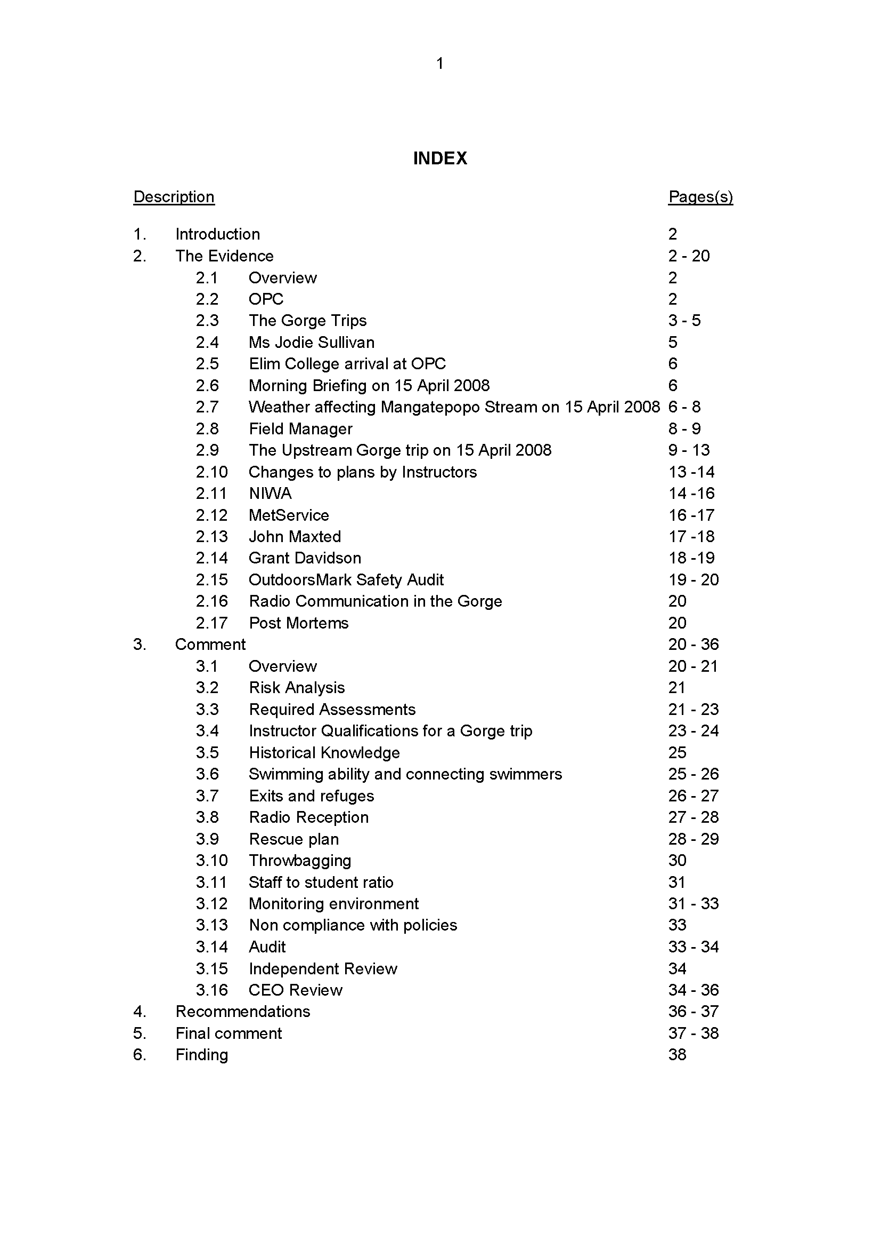
NZ Coroner’s Report

Slide 40
Mangatepopo River Accident, NZ
Government
Government Policy & Budgeting
Lack of Legistation for outdoor centers
Regulations & Associations
Regulatory Bodies & Associations
Inadequate Auditing System
Company
Company Culture & Management
Inadequate consent form
Inadequate employee training/mentoring
Supervision & Management
Technical & Operational Management
Instructor belief they were competent to lead trip
Participants & Staff
Physical Process & Activity
Unconfident swimmers in group
Adverse Event
Work/Activity
Equipment & Environment
Notes:
https://link.springer.com/article/10.1007/s10111-019-00596-x

Slide 41
Notes:
https://activeeducationmagazine.wordpress.com/2012/09/05/understanding-accidents-in-the-great-outdoors-the-human-factors-approach/

Slide 42
What’s Going Wrong?
Safety I Approach

Slide 43
Safety II
“Safety management should therefore move from ensuring that ‘as few things as possible go wrong’ to ensuring that ‘as many things as possible go right’. We call this perspective Safety-II;”¹
1 Hollnagel, E. Hearns, R., Braithwaite, J. - EUROCONTROL (2013). From Safety-I to Safety-II (A White Paper). Brussels.
Notes:
From Safety-I to Safety-II: A White Paper
https://www.england.nhs.uk/signuptosafety/wp-content/uploads/sites/16/2015/10/safety-1-safety-2-whte-papr.pdf

Slide 44
What’s Going Right
Safety II Approach

Slide 45
Safety I & Safety II
https://www.cefa-aviation.com/safety2-swiss-cheese-model/
Notes:
https://www.cefa-aviation.com/safety2-swiss-cheese-model/

Slide 46
Safety I vs Safety II
Safety I
Safety II
Learn from our Errors
Safety defined by absence of problems
Reactive Approach
Understand what goes wrong
Focus on accident causation
Avoid error behavior
Reduce losses
Learn from our Successes
Safety defined by presence of success
Proactive Approach
Understand what goes right
Repeat what goes right
Reinforce successful behavior
Create successful behavior
https://safety4sea.com/cm-safety-i-vs-safety-ii-an-overview/
Notes:
https://safety4sea.com/cm-safety-i-vs-safety-ii-an-overview/

Slide 47
Using Both Paradigms
Not Safety I OR Safety II
It is Safety I AND Safety II

Slide 48
Using the Whole Spectrum
Safety I & Safety II

Slide 49
Managing the Risk Gap/ Setting the Bar
Activity Level Bar
Risk Gap
Activity Level Bar
Judgment
Field Experience
Evaluation
Protocols
Training
Risk Gap
{
Judgment
Field Experience
Evaluation
Protocols
Training
Safety II
College Outdoor Program
Professional Outdoor Program

Slide 50
Safety II – What Needs to Go Right
Activity Level Bar
Risk Gap
Judgment
Field Experience
Evaluation
Protocols
Training
Leadership
Group Dynamics
Emergency Procedures
Risk Management
First Aid
Conservation Ethics
Diversity & Inclusion
Build Your Safety II Stack

Slide 51
Diversity & Inclusion Risks
Physical Safety is only one dimension on the Risk Management spectrum
Emotional Safety is equally important and Hazards can be equally life threatening
Teens committing suicide after bullying
LGBTQ individuals being harassed
Sexual harassment
Talk to your staff about where there are Emotional/Interpersonal Hazards, Assess the Risk Level, and establish the necessary guidelines, structures, protocols, culture to manage the risk

Slide 52
Safety II = Preventimaps
If Safety I = Accimaps (hazard analysis) “What went wrong?”
then
Safety II = Preventimaps (mitigation analysis) “What went right?”

Slide 53
Title IX Implementation on Campus
Government
Government Policy & Budgeting
Title IX Legislation
Regulations & Associations
Regulatory Bodies & Associations
Department of Education Auditing System
Company
Company Culture & Management
Policies & Procedures
Campus Education Programs
Supervision & Management
Technical & Operational Management
Instructors taught how to manage inappropriate sexual remarks/contact
Participants & Staff
Physical Process & Activity
Participants taught active intervention strategies
Work/Activity
Equipment & Environment
Cornelissen & Trotter, 2012, Safety Science
Notes:
Using Title IX as an example. First, no system is perfect and Title IX certainly is not.

Slide 54
Safety II and COVID-19
Resiliency & Protocol Change
Two patients on one Ventilator
Using CPAP machines (for sleep apnea) as Ventilators
Reusing PPE
Ski Goggles for PPE

Slide 55
COVID-19 Decision Premises
Participant/Client Safety
Staff Safety
Organization Safety

Slide 56
Safety II Decision Tree

Slide 57
Implementing RASM
Reduce Probability
Reduce Severity
Reduce Both
Make everyone on staff is a risk manager (lower case)

Slide 58
Implementing RASM
Look at each activity you do and assess…
Hazard Factors in each of these categories…
Environment
Equipment
People
Safety Factors in each of these categories…
Environment
Equipment
People
Notes:
This slide explores how to implement the RASM model in your program. For each activity (backpacking, rock climbing, etc.) you should
Assess the Hazard Factors
Environmental Hazard Factors
Equipment Hazard Factors
People Hazard Factors
Assess your Safety Factors to deal with the potential hazards
Environmental Safety Factors
Equipment Safety Factors
People Safety Factors
Decide if the Risk Level is acceptable
Based on your assessment you need to decide if this activity can be done at an acceptable risk level given your program’s resources.

Slide 59
Implementing RASM
What Risk Level(s) you are comfortable operating with and are appropriate for your program goals/mission?
Develop an Incident Reporting and Tracking System
Notes:
This slide explores how to implement the RASM model in your program. For each activity (backpacking, rock climbing, etc.) you should
Assess the Hazard Factors
Environmental Hazard Factors
Equipment Hazard Factors
People Hazard Factors
Assess your Safety Factors to deal with the potential hazards
Environmental Safety Factors
Equipment Safety Factors
People Safety Factors
Decide if the Risk Level is acceptable
Based on your assessment you need to decide if this activity can be done at an acceptable risk level given your program’s resources.

Slide 60
Implementing RASM
Utilize incident data collection & Safety I approaches for addressing adverse outcomes & close calls
Utilize Safety II approaches for maximizing what drives success in your program
Notes:
This slide explores how to implement the RASM model in your program. For each activity (backpacking, rock climbing, etc.) you should
Assess the Hazard Factors
Environmental Hazard Factors
Equipment Hazard Factors
People Hazard Factors
Assess your Safety Factors to deal with the potential hazards
Environmental Safety Factors
Equipment Safety Factors
People Safety Factors
Decide if the Risk Level is acceptable
Based on your assessment you need to decide if this activity can be done at an acceptable risk level given your program’s resources.

Slide 61
Take Home Action Steps
Balance the Hazard Factors against the Safety Factors and determine the range of Risk Levels you will be operating in. Based on your program, decide whether the Risk Level is acceptable or not.
If the Risk Level is not acceptable, assess how to modify Hazard Factors and Safety Factors to reduce the Risk Level.
Establish what “Bailing Out” means in your program and applaud people who make that decision.

Slide 62
Take Home Action Steps
Have RASM be a part of staff training so that co-leaders can raise hazard and safety ball issues with each other
Ask your staff to analyze some of their own near misses (program or personal) as a learning tool
Develop your own program stories (maintain confidentiality)
Build a culture that encourages incident & near miss reporting (We can’t fix what we don’t know).
Have your students/staff think about how this model applies to their lives back on campus – for example seeing someone who is severely intoxicated

Slide 63
Final Thoughts
The biggest mistake
about a mistake
is not learning from it.

Slide 64
Resources
www.OutdoorEd.com
www.IncidentAnalytix.com
Search for RASM for Downloads
https://youtu.be/yBRJdWmKVjI
Copyright © 2020 Rick Curtis, Outdoor Ed LLC. All rights reserved.

